Slide 1
Proposal Presentation
Team collaboration system
for mobility water monitoring
By….
Peerapong Chompootepa 542115044
Worrasete Tansurat 542115056

Slide 2
Agenda
Introduction
Literature Reviews
Quality Standard
Project Plan

Slide 3
Introduction

Slide 4
Literature Review
Business Review
Technology Review
Development Tools Review

Slide 5
Business Review

Slide 6




Technology Review

Slide 7



Development Tools Review

Slide 8
Project Plan
Motivation
Aims and Objectives
Deliverables and Limits
Schedule & Milestones

Slide 9
Motivation

Slide 10
Aims and Objectives
Aims
The aim of this project is to develop the Team collaboration system for mobility water monitoring in order to share test information to the working team.

Slide 11
Aims and Objectives
Objectives
To create the central system support team collaboration
To help managing project teams
To help identifying the collectors responsibility
1.
2.
3.

Slide 12
Aims and Objectives
Objectives
To help sharing all test results aggregated to the evaluation
To be able to trace back the test result from the research center
To reduce the time of working as a team
4.
5.
6.

Slide 13
Deliverables
Consist of 3 parts >>>
Web application Part (Administrator and Team leader)
Feature 1: Login and logout
Feature 2: Manage the team project
Feature 3: Create location on the map
Feature 4: View all results of all team members
Feature 5: Send message to the collector’s mobile

Slide 14

Deliverables
Mobile Part (Team leader)
Feature 6: Login and logout
Feature 7: View all results of all team members
Feature 8: Send message to the collector’s mobile

Slide 15

Deliverables
Mobile Part (Collector)
Feature 9: Login and logout
Feature 10: Modify map
Feature 11: Manage test folders to be consistent to team collaboration

Slide 16

Limits
>>The internet connection is required for using this system and application.
>>Smart device, which are using Android OS.
User should have account for access to the system.
>>Website support only English language.

Slide 17


Future work
Can support with other platform (iOS).

Slide 18
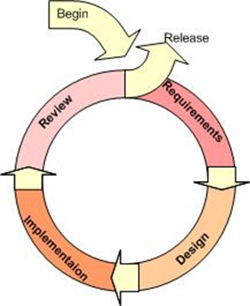
Iterative Model

Slide 19
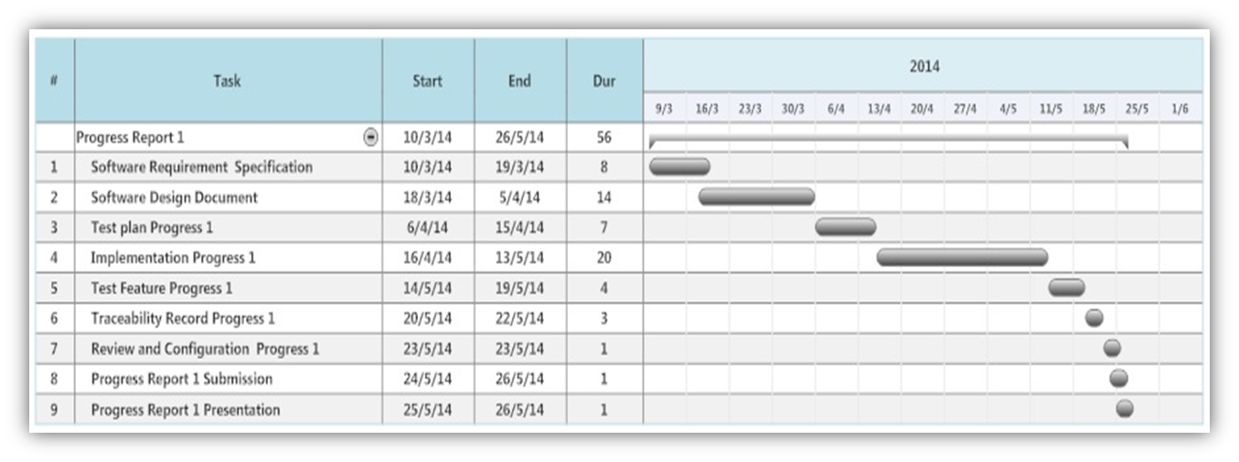
Schedule & Milestone
Progress 1
Web application Part (Administrator and Team leader)
Feature 1: Login and logout
Feature 2: Manage the team project
Feature 3: Create location on the map
Feature 4: View all results of all team members
Feature 5: Send message to the collector’s mobile

Slide 20
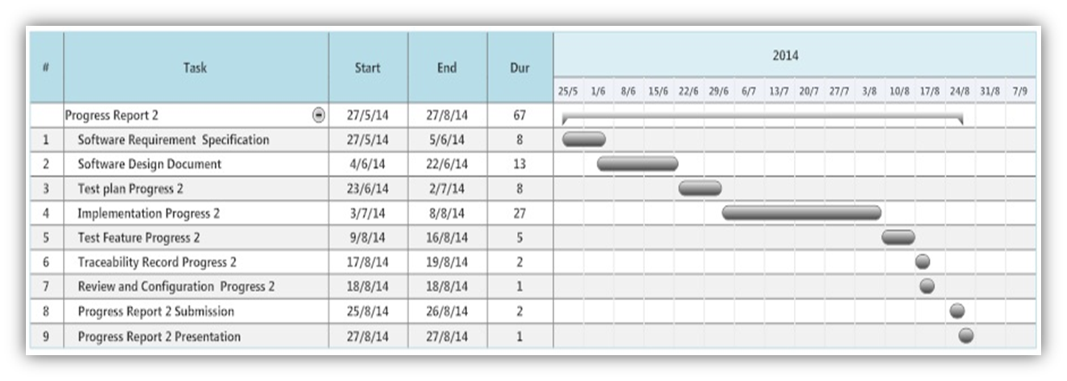
Schedule & Milestone
Progress 2
Mobile Part (Team leader)
Feature 6: Login and logout
Feature 7: View all results of all team members
Mobile Part (Collector)
Feature 9: Login and logout
Feature 11: Manage test folders to be consistent to team collaboration

Slide 21
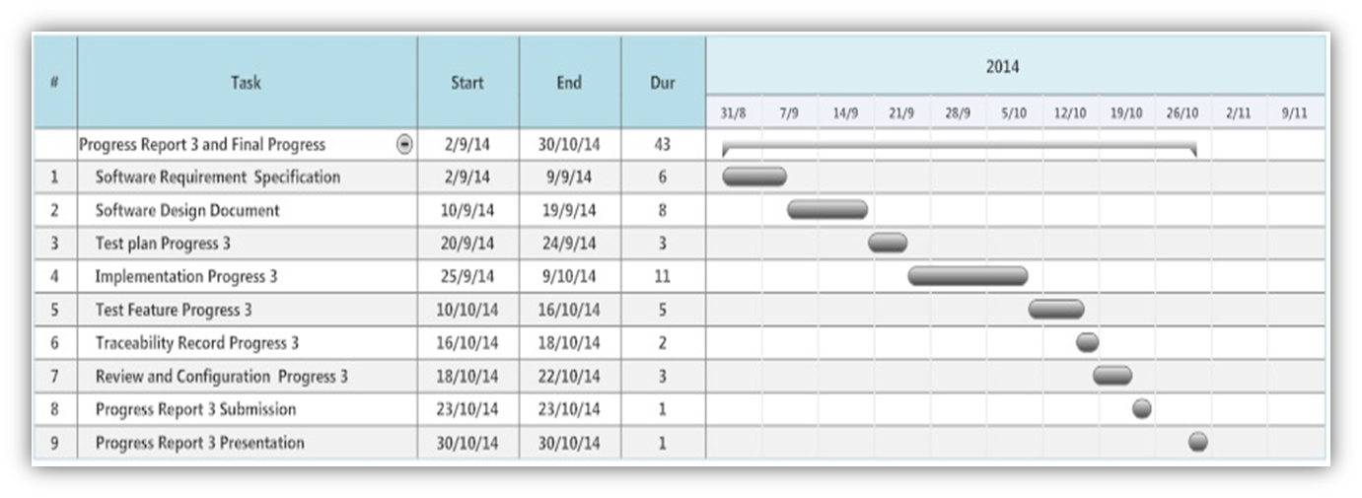
Schedule & Milestone
Progress 3
Mobile Part (Team leader)
Feature 8: Send message to the collector’s mobile
Mobile Part (Collector)
Feature 10: Modify map

